Slide 1
Chapter 4 Findings and Discussion
Dr Andre Samuel
2026

Slide 2
Purpose
Present the results of what you found
Discuss the Findings i.e. important results
Interpret the Findings, towards your research objective and then towards your Research Question
  i.e. answering the RQ
2000 words

Slide 3
Step 1- Plan out the structure of the chapter
Use your research objectives
Each objective will be a major heading
  e.g. 4.1 Findings for the factors that affect job satisfaction
Then for each major heading work out the sub-headings
  4.1.1 Working Conditions
  4.1.2 Pay
  Be guided by your Concepts/Themes/Variables from the Methodology Matrix
Repeat for each objective until you have the full structure for the chapter

Slide 4
Generic Structure
4.0 Introduction
  Provide purpose of the chapter
  Restate RQ
  Therefore, the subsequent sections of this chapter will address…..
4.1 Findings for Objective 1
4.1 Findings for Objective 2
4.1 Findings for Objective 3

Slide 5
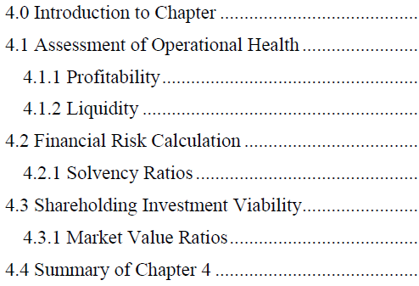
Example Structure 1
Research Objectives:
1. To assess the operational health of Tata Global Beverages Limited using ratio analysis
2. To determine the financial risk level of Tata Global Beverages Limited
3. To calculate whether or not investment in Tata Global Beverages will be fruitful to stockholders

Slide 6
Step 2- Your Data Analysis- Qualitative using only Articles
Create a table mapping out the objectives and the key results you found relating to it
So go through all the articles, documents and research you have so far
Find more if necessary.
Sort by Objectives
Once you do this, you will see what you need to write up under each heading in chapter 4
That is, you will use the table to build your Discussion of the findings

Slide 7
Study | Key Audit Quality Indicator Examined | IFRS Reliability Indicator | Key Findings | Linked Research Objective
DeAngelo (1981) | Auditor size (Big auditor vs small auditor) | Financial reporting credibility | Larger audit firms tend to deliver higher audit quality due to stronger independence and reputation incentives. | Objective 1
Francis & Yu (2009) | Big 4 auditor presence | Earnings quality | Firms audited by Big 4 auditors show lower discretionary accruals, suggesting higher financial reporting reliability. | Objective 3
Knechel et al. (2013) | Audit tenure and audit effort | Financial statement reliability | Audit quality improves with auditor expertise but very long tenure may threaten independence. | Objective 1
Siregar & Utama (2008) | Audit firm size | Earnings management | Companies audited by higher quality auditors exhibit lower earnings manipulation. | Objective 3
Alzoubi (2018) | Auditor specialization | Accrual quality | Industry-specialized auditors improve reporting quality and reduce financial misstatements. | Objective 3
IFAC / IAASB reports | Audit process quality | Compliance with IFRS standards | Strong audit procedures improve the reliability and transparency of financial reporting. | Objective 2

Slide 8
Step 2- Your Data Analysis- Quantitative using Financial Analysis
Before you can write up chapter 4, you must analyse your data
This involves locating all the financial data from your sources
Then performing the financial analysis and/or statistical analysis
This is where you will use MS Excel for:
  Ratio Analysis
  Correlation
  Regression

Slide 9
Example 1:
RQ: To what extent does working capital management influence the profitability of selected companies over a three-year period?
Objectives
1. To analyse the working capital position of three firms over a three-year period using key working capital ratios.
2. To evaluate the profitability performance of the selected firms over the same period.
3. To examine the relationship between working capital management and profitability of the firms

Slide 10
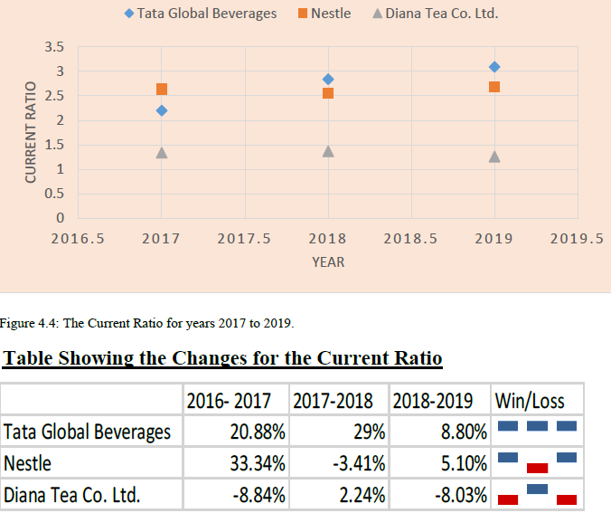
Analysis for Objective 1
Method: Ratio Analysis and Trend Analysis
Analytical Steps
  Calculate working capital ratios for each firm
  Compare ratios across years (trend analysis)
  Compare ratios between firms (cross-firm comparison)
Graphs/Charts
  Graph of Current Ratio by year
  Graph of Receivable Days
  Graph of Inventory Turnover

Slide 11
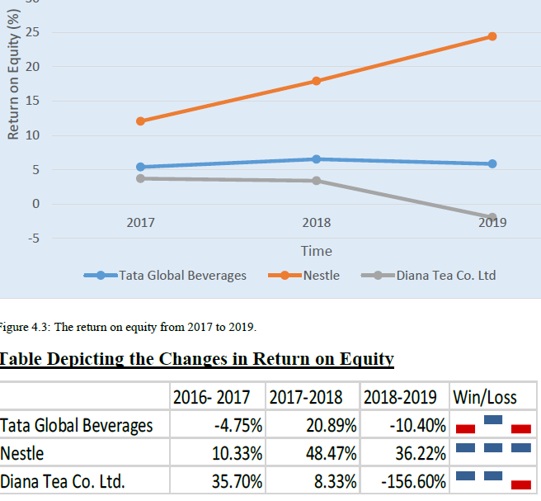
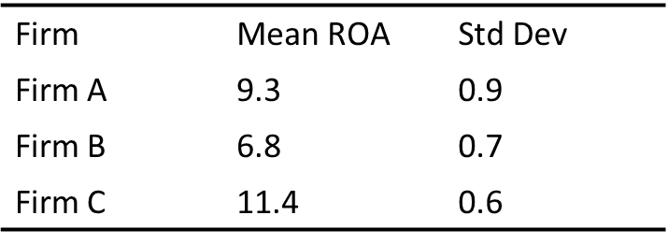
Analysis for Objective 2
Method: Profitability Ratio Analysis
Analytical Steps
  Calculate profitability ratios for each firm.
  Compare profitability across the three years.
  Compare profitability between firms.
  Descriptive Statistics- mean, std. dev for each firm

Slide 12
Analysis for Objective 3
Method: Correlation and Regression
Dependent Variable (Profitability)
  ROA (Return on Assets)
Independent Variables (Working Capital)
  Current Ratio (CR)
  Inventory Turnover (IT)
  Receivable Days (ARD)
ROA= β0​ + β1​(Current Ratio) + β2​(Receivable Days) + β3​(Inventory Turnover)

Slide 13
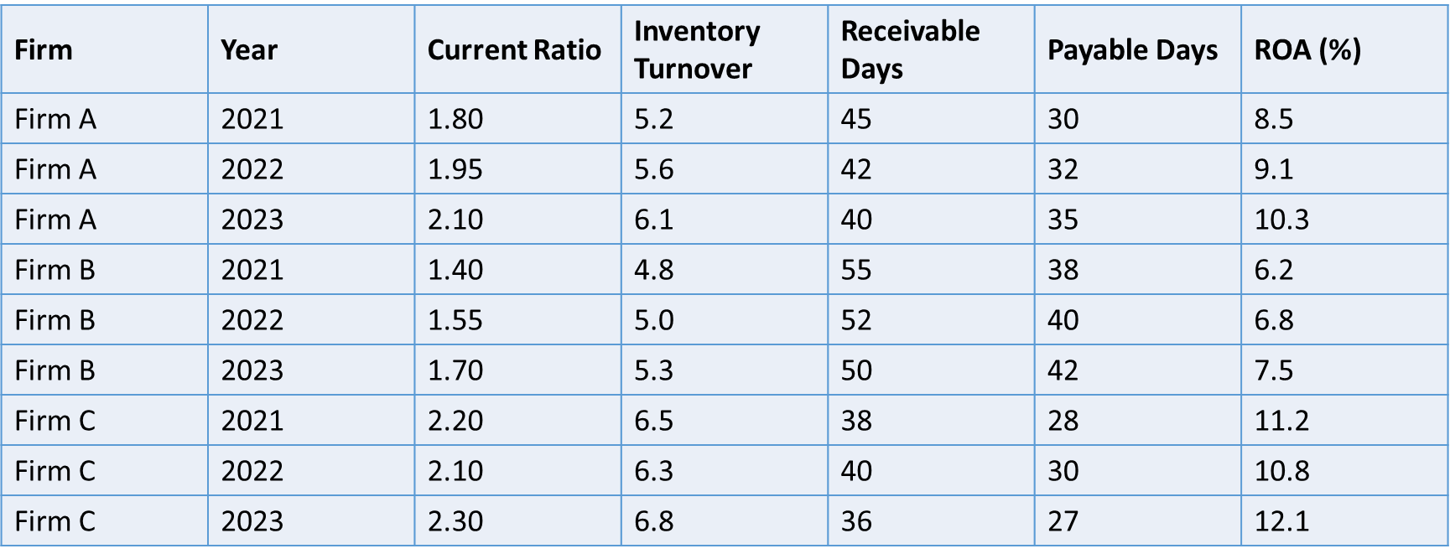
Analytical Steps
  Using Excel setup panel data
  Run Correlation analysis
  Run Regression Analysis

Slide 14
Report Correlation
Report Regression

Slide 15
Example 2:
RQ: To what extent does ESG disclosure influence investor-related financial performance in three publicly listed firms over a three-year period?
Objectives:
To analyse the level and trend of ESG disclosure among selected firms over a three-year period.
To examine the relationship between ESG disclosure and firm financial performance indicators, including ROA and ROE.
To evaluate the impact of ESG disclosure on investor-related market outcomes measured by share price.

Slide 16
Analysis for Objective 1
Method: Descriptive statistics
  Mean ESG score
  Minimum and maximum values
  Standard deviation
Trend analysis
  Compare ESG scores across years
  Identify whether ESG disclosure increases or decreases.
Visualisation
  Line charts showing ESG scores for each firm over time.

Slide 17
Analysis for Objective 2
Method: Correlation and Regression.
Step 1: Correlation analysis
  Pearson correlation coefficient between:
    ESG Score
    ROA
    ROE

Slide 18

Step 2: Regression model
2 Models:
  $ROA_{it}=β_{0}+β_{1}ESGScore_{it}+ε_{it}$
  And
  $ROE_{it}=β_{0}+β_{1}ESGScore_{it}+ε_{it}$

Slide 19
Example Panel Data
Firm | Year | ESG_Score | Share_Price_USD | ROA_% | ROE_%
Firm_A | 2021 | 58 | 24.50 | 5.2 | 11.4
Firm_A | 2022 | 64 | 27.10 | 5.8 | 12.6
Firm_A | 2023 | 71 | 30.40 | 6.4 | 13.9
Firm_B | 2021 | 46 | 18.20 | 3.9 | 8.7
Firm_B | 2022 | 51 | 19.60 | 4.3 | 9.5
Firm_B | 2023 | 57 | 21.30 | 4.9 | 10.8
Firm_C | 2021 | 67 | 32.80 | 6.1 | 14.2
Firm_C | 2022 | 70 | 34.50 | 6.5 | 15.0
Firm_C | 2023 | 76 | 37.20 | 7.0 | 16.1

Slide 20
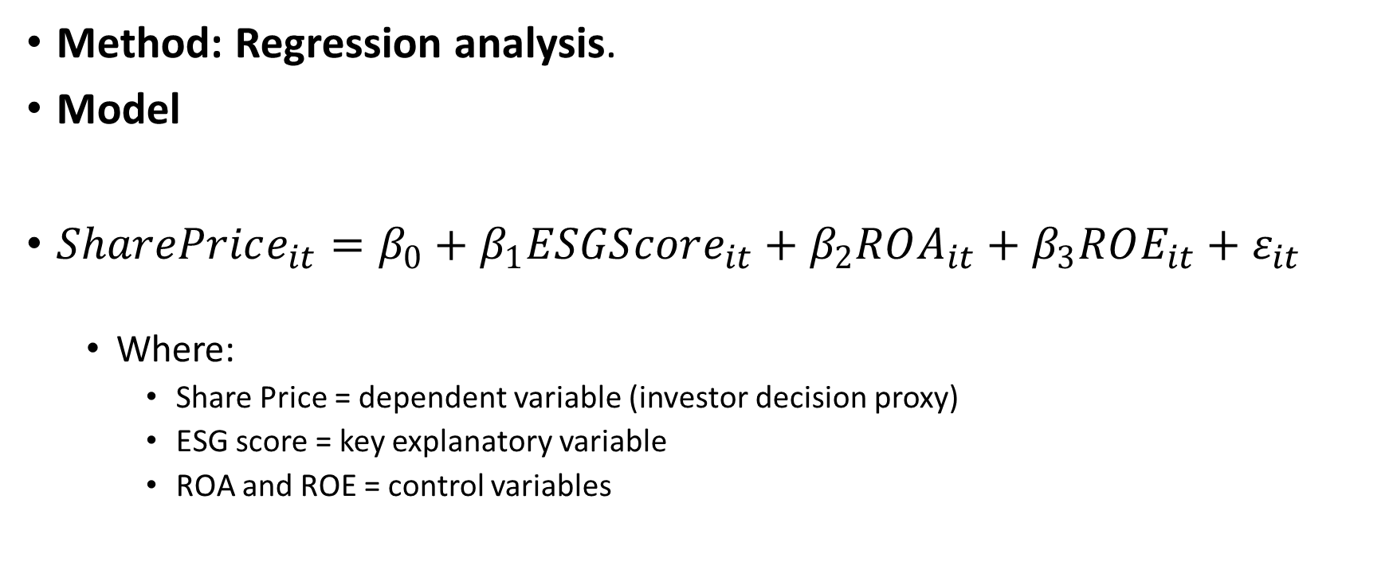
Analysis for Objective 3
Method: Regression analysis.
Model
$SharePrice_{it}=β_{0}+β_{1}ESGScore_{it}+β_{2}ROA_{it}+β_{3}ROE_{it}+ε_{it}$
  Where:
    Share Price = dependent variable (investor decision proxy)
    ESG score = key explanatory variable
    ROA and ROE = control variables

Slide 21
Step 3- Start Writing up each section
Now that you have completed the data analysis, you can start the write up of each section as planned.
The following should be done:
Present results
Write up a discussion of the results, compare across firms etc
Derive the key finding- the trend, generalization
Interpret the finding

Slide 22
The interpretation
This is the key part.
What does the finding mean:
  Think of the research objective, what were you trying to find out?
  What is the finding saying?
  Form a reasoned judgement
This is where you:
  connect findings to theory
  compare with previous studies
  explain why results occur

Slide 23
Example 1:
The results indicate a moderate positive relationship between digital adoption and profitability, as evidenced by a correlation coefficient of 0.58.
This suggests that firms with higher levels of technology investment tend to achieve improved financial performance. However, this relationship is not uniform across all firms, with Firm C displaying weaker alignment, possibly due to differences in implementation efficiency.
These findings are consistent with prior studies which highlight the role of digital capabilities in enhancing operational efficiency, although the variability observed suggests that digital investment alone is insufficient without effective integration.

Slide 24
Example 2:
The descriptive analysis of ESG disclosure across the three firms over the 2021–2023 period reveals a clear upward trajectory, with the mean ESG score increasing from 57.0 to 68.3, indicating a consistent strengthening of sustainability reporting practices. Firm C maintained the highest ESG performance throughout, while Firm A demonstrated the most notable improvement, suggesting a more strategic shift towards enhanced disclosure. This pattern is consistent with prior empirical evidence.
For example, KPMG (2020) reports that over 80% of large companies globally have increased ESG disclosures in response to regulatory and stakeholder pressures. Similarly, Gunnar Friede et al. (2015), in a meta-analysis of over 2,000 studies, find a growing positive trend in ESG reporting and its integration into corporate strategy.
The convergence in ESG scores across firms also reflects institutional theory, where firms imitate industry leaders to maintain legitimacy.
The observed increase in ESG disclosure can further be explained through signalling theory, whereby firms voluntarily enhance transparency to reduce information asymmetry and present themselves as lower-risk to investors (Spence, 1973).
Overall, the findings align strongly with established literature, suggesting that ESG disclosure improvements are driven by a combination of regulatory evolution, competitive pressures, and strategic efforts to influence investor perceptions and long-term firm valuation.

Slide 25
Example 3:
See handout

Slide 26
Language is important
Check:
https://www.phrasebank.manchester.ac.uk/reporting-results/
https://www.phrasebank.manchester.ac.uk/discussing-findings/

